Slide 1

Judicial Case Insights: Analysis of Pending Court Cases
SIMRAN SHARMA

Slide 2
Objective
Analyze Case Trends: Understand the distribution and trends of pending cases in District, Taluk, and High Courts across various categories and time periods.
Support Judicial Efficiency: Identify bottlenecks and trends to assist in resource allocation, reduce pendency, and improve judicial performance.
Enable Policy Decisions: Provide actionable insights to support policy-making aimed at judicial reforms and better resource management.
Focus on Vulnerable Groups: Highlight cases filed by senior citizens and women to ensure targeted attention for timely resolution.

Slide 3
DATASET OVERVIEW
District Court Dataset Overview:
The District Court dataset includes case types (Civil, Criminal, Total), pending cases across various time periods, case stages, and cases filed by senior citizens and women. It also tracks cases instituted and disposed in the last month.
High Court Dataset Overview:
The High Court dataset captures case types (Writ Petition, Appeal, Criminal, Civil) with pending cases across time periods. It tracks cases filed by senior citizens and women, as well as cases instituted and disposed in the last month, segmented by High Court benches.
Dataset: National Judicial Data Grid Dataset

Slide 4
DISTRICT COURT CASE INSIGHTS (AS OF JULY 2024)

Slide 5
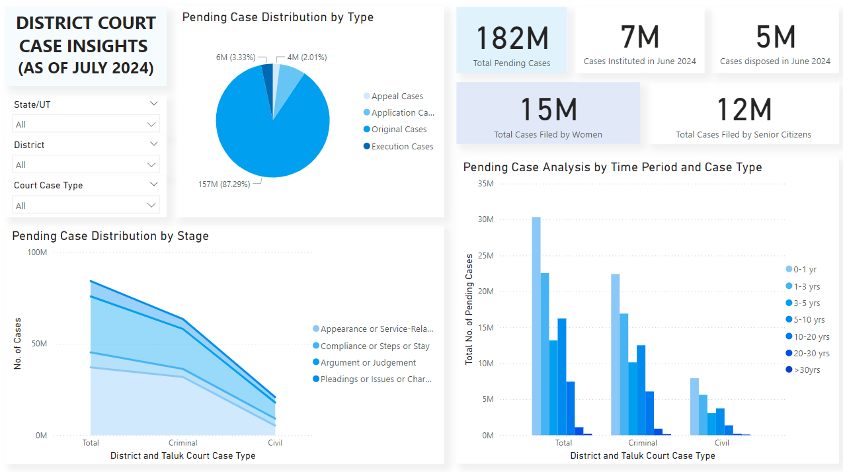

Slide 6
District Court Key Performance Indicators
Total Pending Cases: 182M
Cases Filed by Women: 15M (8.2% of Total)
Cases Filed by Senior Citizens: 12M (6.6% of Total)
Cases Instituted (as of June 2024): 7M
Cases Disposed (as of June 2024): 5M

Slide 7
District Court CASE Insights – PART 1
Original Cases Dominance: Original cases constitute 87.29% of all pending cases, indicating a significant backlog at the initiation stage of judicial proceedings.
Time-Based Trends: Most cases are pending for less than 1 year (30M total), suggesting recent filings dominate the backlog, requiring focused resource allocation.
Criminal Cases Backlog: Criminal cases significantly outweigh civil cases across all time ranges, with 22.4M pending under 1 year and 16.9M pending for 1-3 years.
Long-Term Pendency: Over 16.2M cases are pending for 5-10 years, highlighting inefficiencies in clearing prolonged cases.
Execution Cases: Despite a smaller share (3.33%), execution cases still account for 6M pending cases, indicating challenges in enforcing judgments.

Slide 8
District Court CASE Insights – PART 2
Women and Senior Citizens: The inclusion of KPIs for women and senior citizens ensures visibility of cases involving vulnerable groups, facilitating targeted judicial interventions.
Case Stages Bottleneck: Most cases are stuck at initial stages (Appearance or Service-Related), requiring procedural streamlining to expedite resolutions.
Civil Cases Backlog: While criminal cases are more numerous, civil cases also contribute significantly to the backlog, indicating a need for additional resources or improvements to expedite their resolution.
State and District Insights: Filters enable granular analysis of state and district-level performance, helping identify regions with acute judicial backlogs.
Resource Allocation: Majority cases in early stages and shorter time periods suggest the need for efficient docket management and resource deployment to prevent backlog escalation.

Slide 9
HIGH COURT CASE INSIGHTS (AS OF JULY 2024)

Slide 10
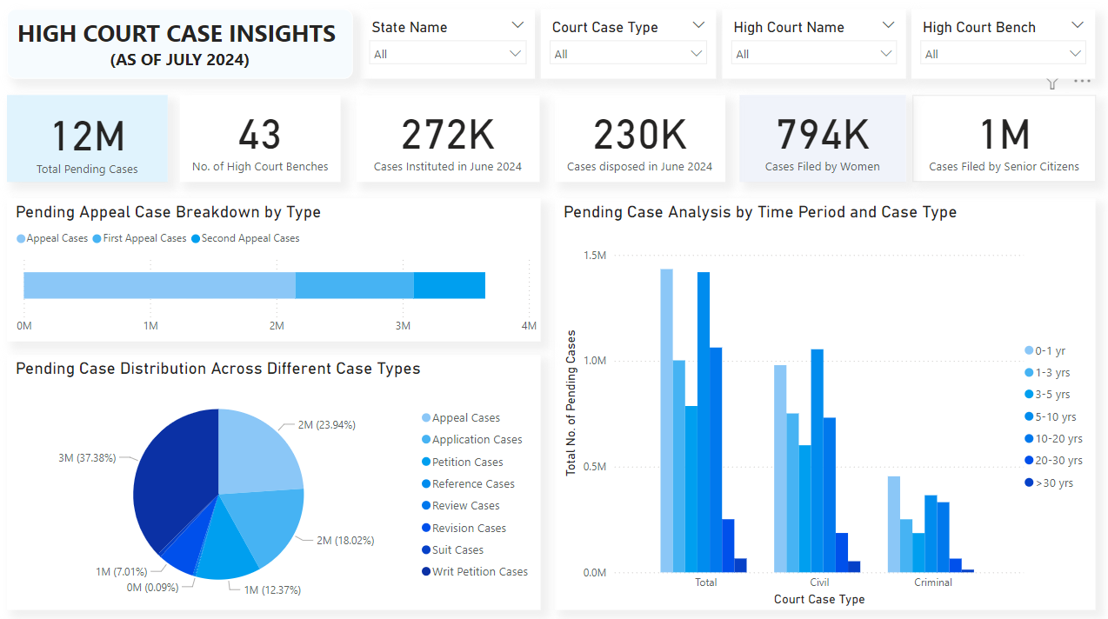

Slide 11
High Court Key Performance Indicators
Total Pending Cases: 12M
Number of High Court Benches: 43
Cases Filed by Women: 794K (6.6% of Total)
Cases Filed by Senior Citizens: 1M (8.3% of Total)
Cases Instituted (as of June 2024): 272K
Cases Disposed (as of June 2024): 230K

Slide 12
HIGH Court CASE Insights – PART 1
Writ Petition Cases Lead: Writ Petition Cases comprise 37.38% of the pending cases, indicating their significant role in judicial delays.
Appeal Cases in Focus: Appeal Cases (23.94%) form a considerable portion of pending cases, highlighting the need for faster appeal resolution.
Application Cases Backlog: Application Cases take up 18.02% of the pie, showing a substantial backlog that may require procedural improvements.
High Proportion of Appeal Cases: First and Second Appeals contribute significantly to the appeal category, indicating their importance in the overall backlog.
Long-Term Pendency in Appeals: High numbers of pending appeal cases (First and Second Appeals) point to challenges in the efficiency of appellate courts.

Slide 13
HIGH Court CASE Insights – PART 2
Diverse Case Types: The pie chart clearly differentiates between various case types, aiding better decision-making on resource allocation and prioritization.
Regional Differences: The Stacked Bar Chart helps identify regional differences across the three appeal case types, offering insights into specific court bottlenecks.
Application Cases Growing Concern: Application Cases, while less than Writ Petitions, still represent a considerable portion of the backlog, necessitating targeted action.
Appeals and Writ Petitions Dominating: Appeal Cases and Writ Petitions dominate the chart, signifying the complexity and volume of cases requiring urgent attention.

Slide 14
Case Management Recommendations
Focus on Reducing Writ Petition Backlogs: Prioritize resolving high-volume writ petition cases.
Accelerate Appeal Case Resolutions: Streamline appellate processes for faster disposal of pending appeal cases.
Enhance Resource Allocation: Allocate resources based on regional case types and time period bottlenecks.
Support Vulnerable Groups: Prioritize cases filed by women and senior citizens for timely justice.
Implement Digital Tools: Adopt advanced case tracking and management systems to improve overall judicial efficiency.

Slide 15
CONCLUSION
In conclusion, the dashboards provide valuable insights into case backlogs and trends. By leveraging these findings, stakeholders can address bottlenecks, prioritize vulnerable groups, and implement data-driven reforms.
Future steps include adopting advanced technologies, improving resource allocation, and fostering collaboration for systemic changes to enhance judicial efficiency and timely justice delivery.

